Slide 1
System Administration
Warehouse Setup: WMS Users
WMS Guide

Slide 2
Table of Contents
Create WMS User……………..........................................................................................4
Modify User………………………………………………………………………………..…………………….…12
Additional Options……………………………………………………………………………………………....18
Copy User…………………………………………………………………………………………………18
Delete User………………………………………………………………………………………….…..23

Slide 3
WMS Users
The WMS Users resource is used to add, modify, and delete the records in the WMS users table, to copy a single user's profile to a new user and to query the records in the WMS users table.
A prerequisite for managing users in the WMS is that the user must already exist in the User table.
After a user is created in the system, a user profile is created for giving access to the WMS application. User profiles have access to certain resources based on the roles they have been assigned.
The roles that are assigned to user profiles are system-designed job functions (e.g., receiver, inventory control, picker, etc.). Roles allow the system administrator to limit a user’s access to the resources relevant to their function.

Slide 4
Create WMS User

Slide 5
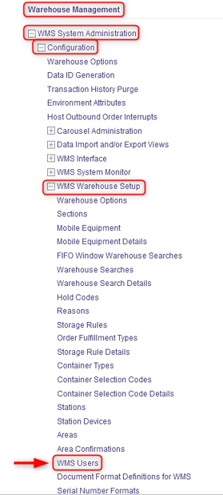
Create WMS User
With a desktop computer, select the WMS System Administration resource.
Under WMS System Administration, click on Configuration.
Under Configuration, click on WMS Warehouse Setup.
Under WMS Warehouse Setup, click on WMS Users.

Slide 6
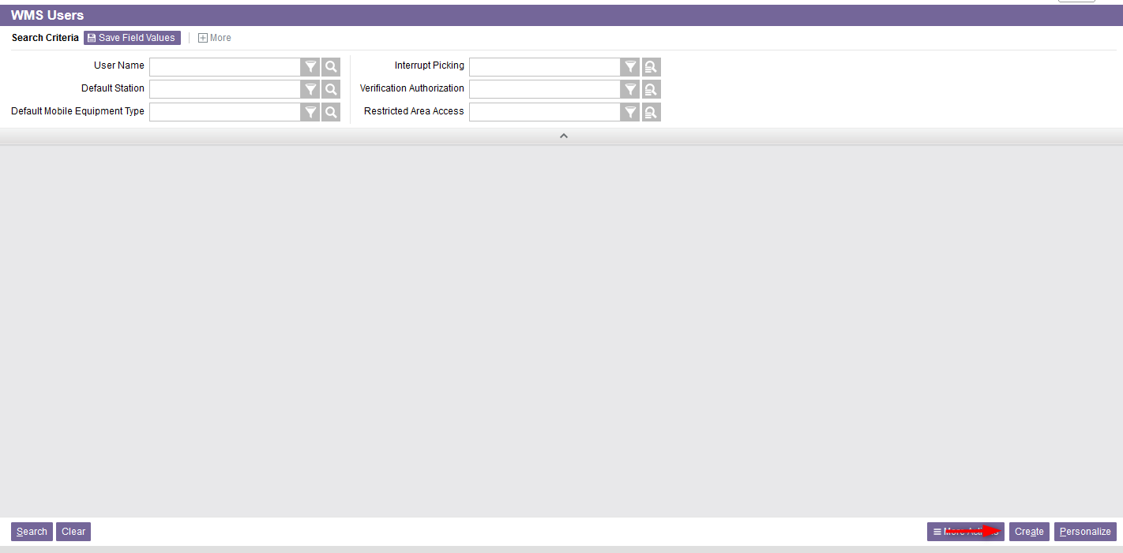
Create WMS User
From the new window, click on Create at the bottom right of your screen.

Slide 7
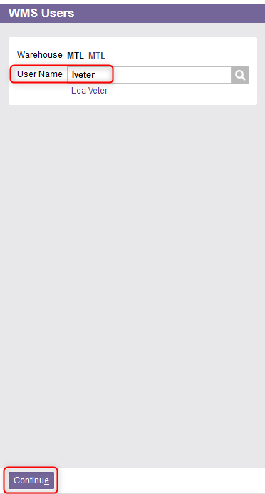
Create WMS User
Enter the User Name.
Click on Continue.

Slide 8
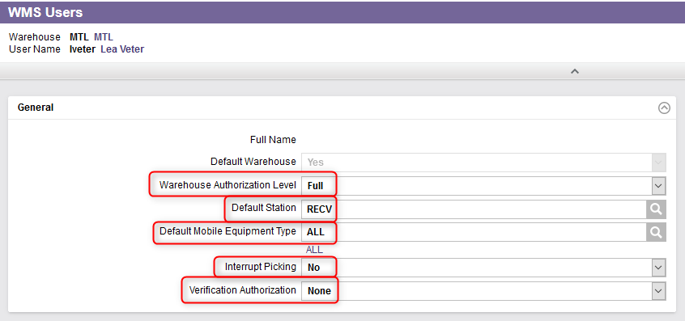
Create WMS User
Complete the General section for the fields shown below. An explanation of the fields is given in the next slides.

Slide 9
Create WMS User
(Continued)
Field | Explanation
Warehouse Authorization Level | Read Only indicates that the user may only query records in the warehouse. Full indicates that the user has full access to create, update, or delete records in the warehouse.
Default Station | This is the default station displayed on the user profile during the login process. This specifies several defaults throughout operations including receiving location, search path, printers, and container types being used.
Default Mobile Equipment Type | This is the default mobile equipment displayed on the user profile during the login process. This is a required entry upon login, and if a default value is not entered, the user will be required to enter this in.

Slide 10
Create WMS User
(Continued)
Field | Explanation
Interrupt Picking | This identifies if the current process a user is working on can be interrupted when a high priority task enters the work queue. No indicates that this user does not process interrupt orders. Yes indicates that the user is always available to process interrupt orders. Prompt indicates that this user is authorized to process interrupt orders but has the ability to indicate if they are available to process the order at that particular time or if they must pass to another picker.
Verification Authorization | This indicates the authorization level with which the user is associated in order to perform the picking verification process. None indicates that the user is not authorized to verify any orders. Level 1 indicates that the user can only verify orders that have been tagged as requiring a level 1 authorized user to verify that order. Level 2 indicates that the user can verify any order no matter the level of authorization identified for the order. The user can verify orders that have been identified for a level 1 or level 2 authorized user.

Slide 11
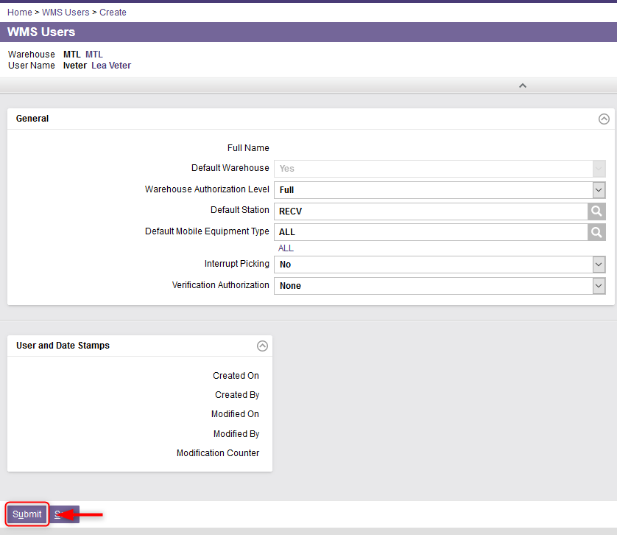
Create WMS User
Once all the required fields in the General section have been completed, click on Submit.
The user will thus be created.

Slide 12
Modify User

Slide 13
Modify User
With a desktop computer, select the WMS System Administration resource.
Under WMS System Administration, click on Configuration.
Under Configuration, click on WMS Warehouse Setup.
Under WMS Warehouse Setup, click on WMS Users.

Slide 14
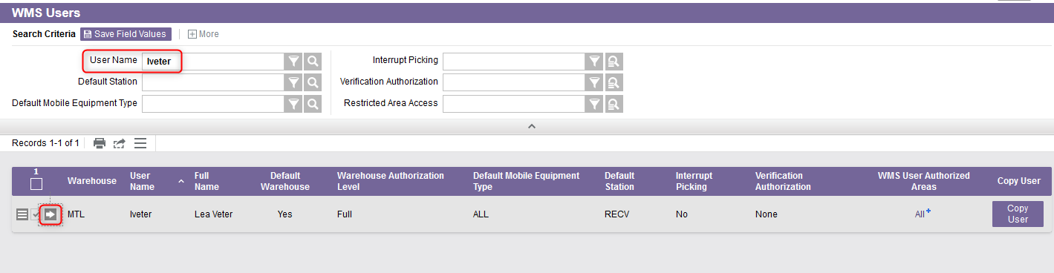
Modify User
Perform a search to retrieve the user you wish to modify and click on View Record Details.

Slide 15
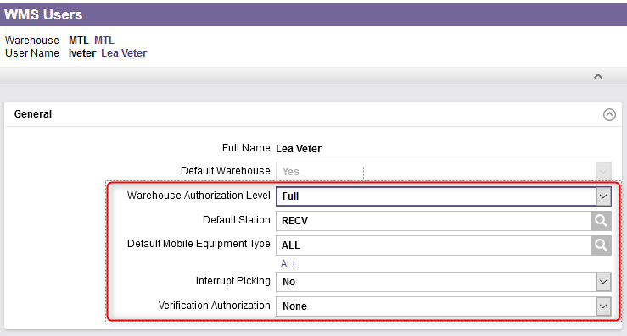
Modify User
Modify the fields in the General section as required. Refer to slides 9 and 10 for a detailed explanation of the different fields.

Slide 16
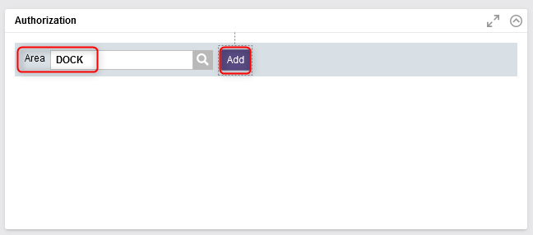
Modify User
In the Authorization section, if needed, add the areas for which the user is authorized to work and click on Add.

Slide 17
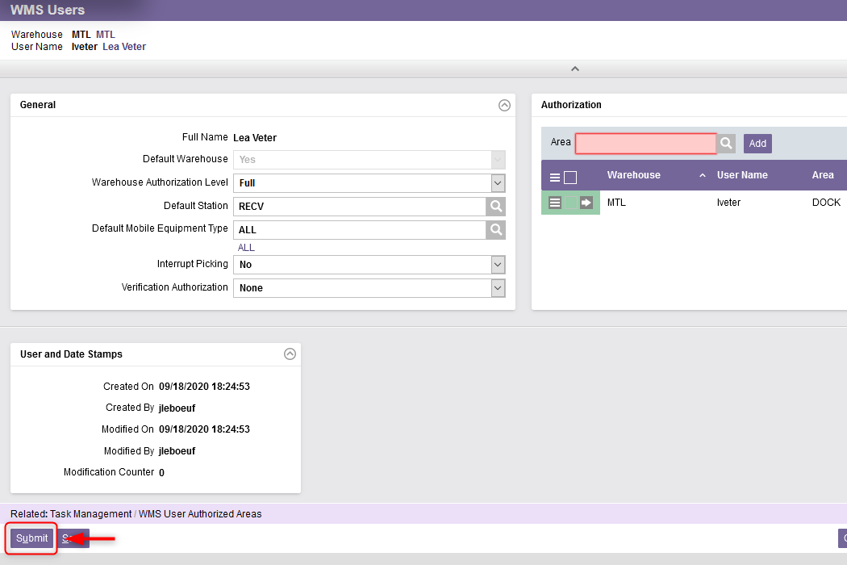
Modify User
Once all the required fields in the sections have been updated, click on Submit.
The user profile will thus be updated.

Slide 18
Additional Options
Copy User

Slide 19
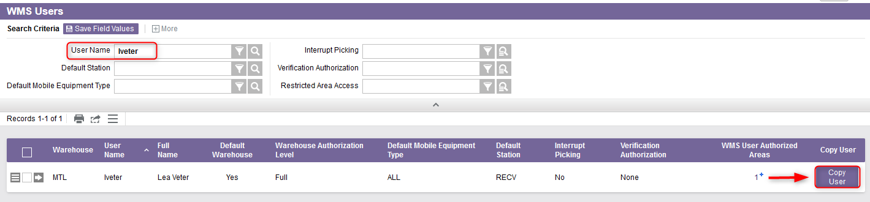
Copy User
If a new user being added will have the same or similar access as another user already existing in the system, you may choose to copy the existing user’s profile and create a new record for the new user. To do this:
Perform a search to retrieve the user’s profile you wish to copy.
Click on Copy User.

Slide 20
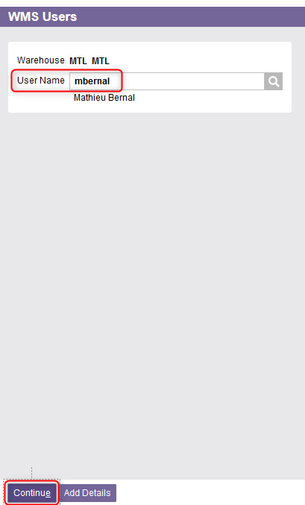
Copy User
Enter the user name of the new user.
Click Continue.

Slide 21
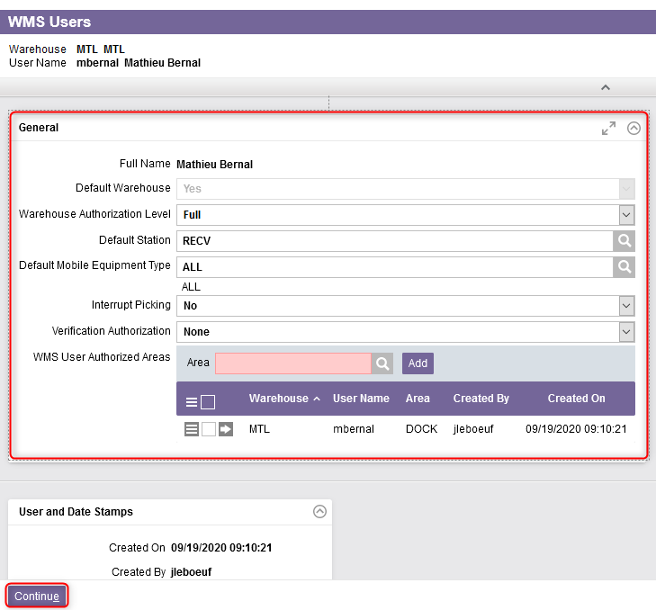
Copy User
Verify the profile settings of the new user and adjust the fields as required.
Click Continue.
The new user will thus be created.

Slide 22
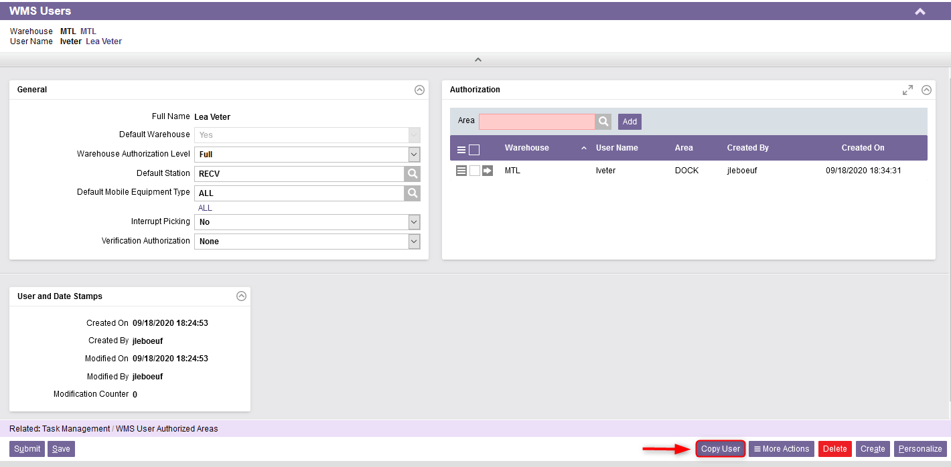
Copy User
Additional Note – When navigating in the Detail View of a user’s profile, the Copy User button also appears in the bottom right of your screen. Follow the same steps as explained previously to copy the existing user to a new profile.

Slide 23
Additional Options
Delete User

Slide 24
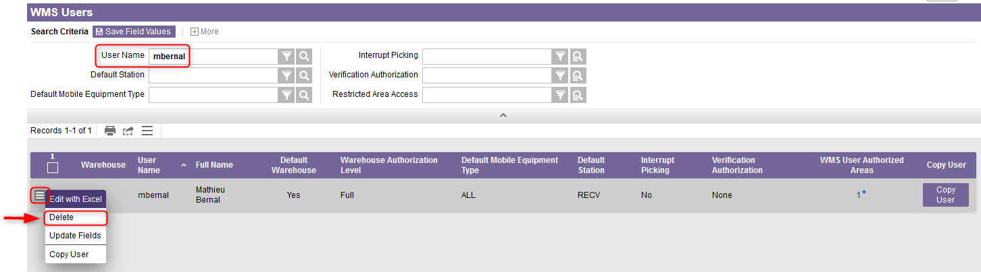
Delete User
Option 1: From the main WMS Users menu, search for the user you wish to delete and click on the Use Record as Criteria for Action button. Then click on Delete.

Slide 25
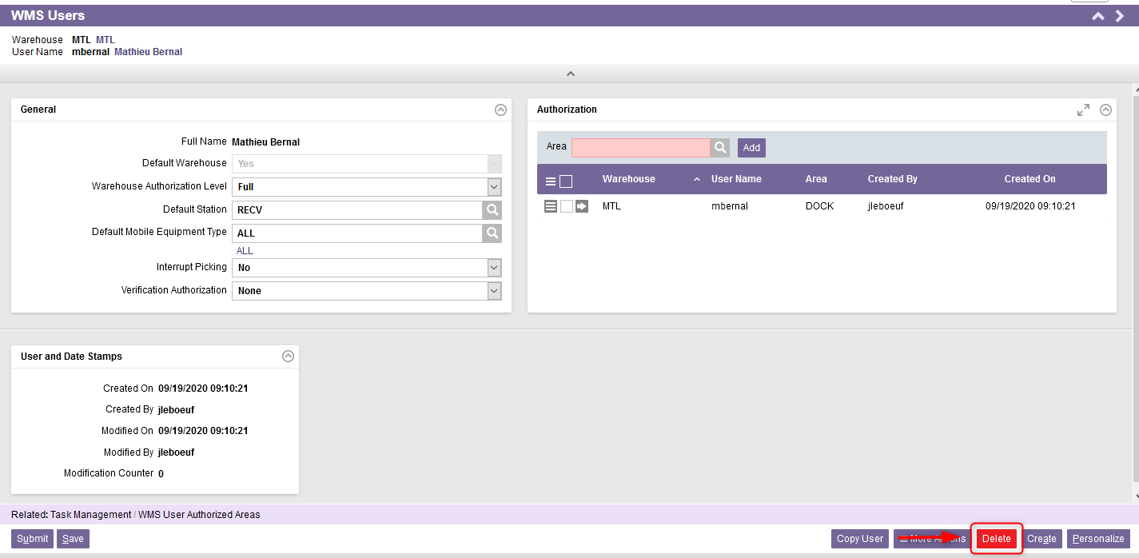
Delete User
Option 2: From the Detail View of a user’s profile, you also have the option to delete the user using the Delete button in the bottom right of your screen.

